Slide 1

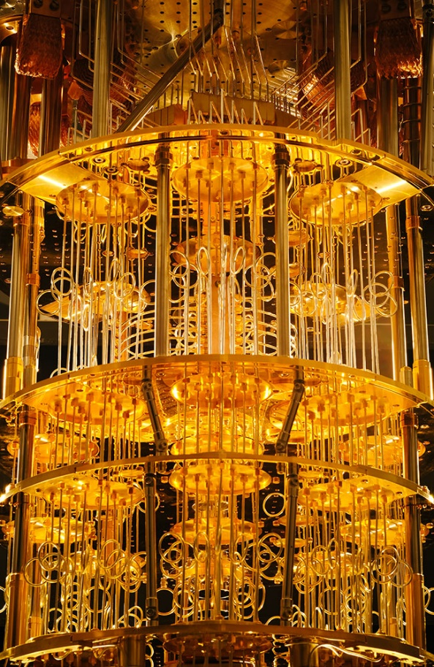
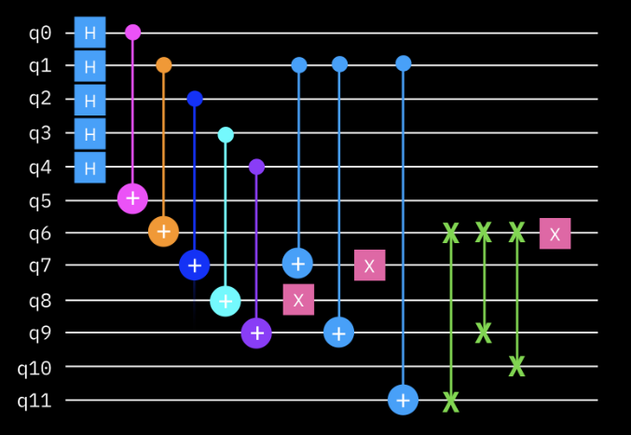
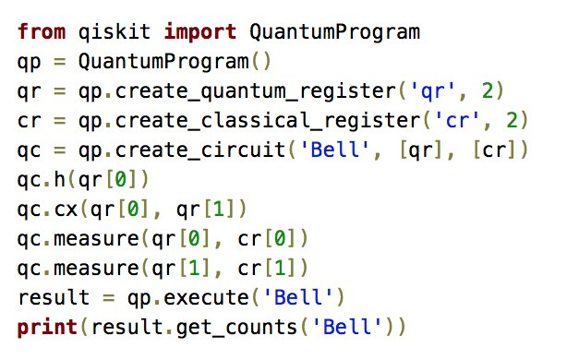
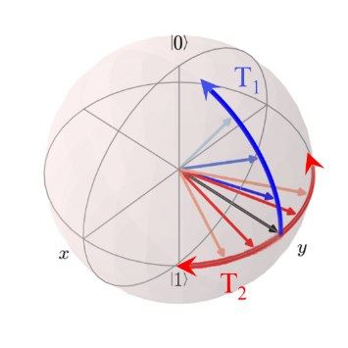

Foundations of
Quantum Computing
(QIS 301)
Dave Biersach
Brookhaven National Laboratory
dbiersach@bnl.gov
Session 01
Introducing
Quantum Computing

Slide 2


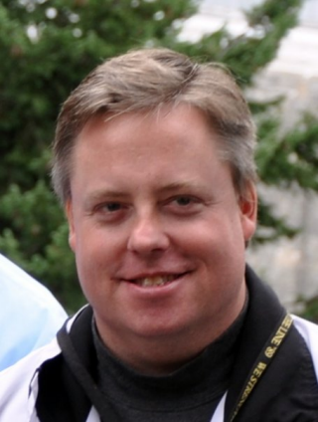

Welcome!
My name is Dave Biersach
I am a Technology Architect at BNL
I am a 1989 graduate of West Point and served in the Persian Gulf War as a Combat Engineer
I did my graduate work at NPS in optimal satellite counter-reconnaissance search algorithms for DARPA
I have worked at Microsoft & Pfizer
I have been married 30 years, have three adult children, and have mentored students for the past 15 years

Slide 3
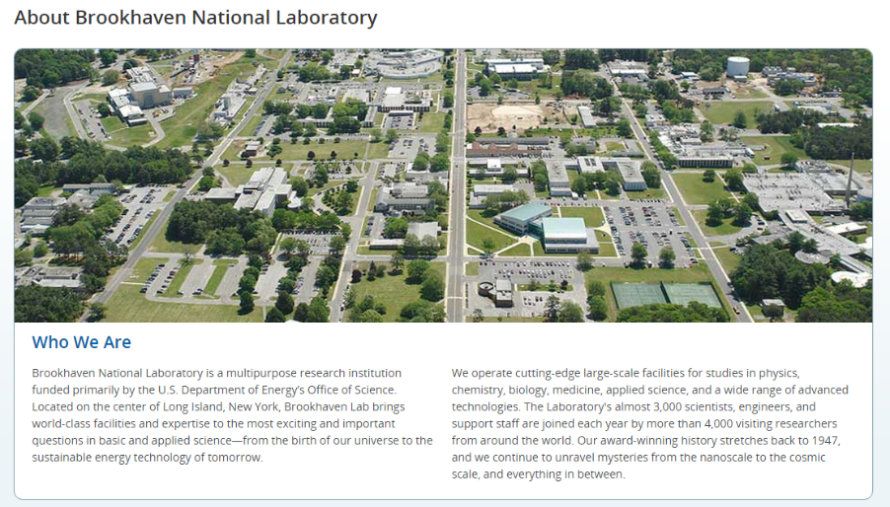

Slide 4
Agenda
Scientific Computing then Quantum Computing
Differentiating CompSci vs. SciComp
SciComp as a Translational Science
Scientific Computing and STEM Internships
How Quantum Computing Relates to SciComp
Workshop Context & Topics
Workshop Expectations

Slide 5
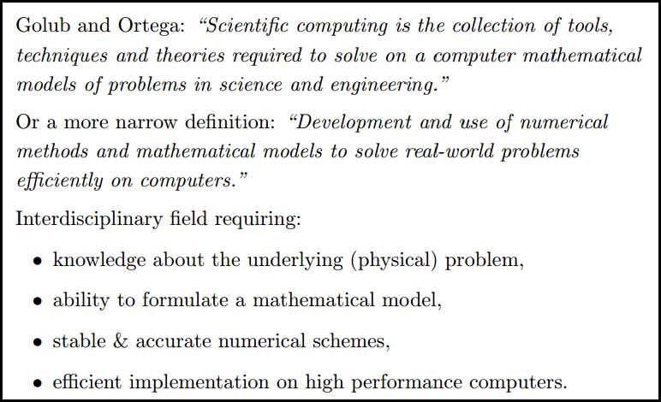
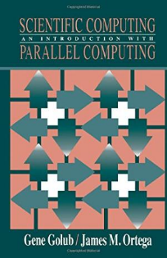
What is Scientific Computing?

Slide 6
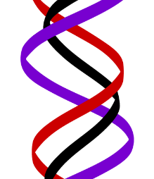
What is Scientific Computing?
Scientific computing problems cannot be solved using just a graphing calculator or a spreadsheet program
A computer should not be viewed as just another closed-form benchtop instrument with fixed functionality
SciComp does not require writing thousands of lines of code to answer problems – complete code usually fits on one slide!
SciComp is applied computer science
The first name of CompSci is computer
The first name of SciComp is science
A triple helix of math, science, and computing

Slide 7
SciComp vs CompSci
Scientific Computing
Computer Science
Probability and Statistics
Simulation and Modelling
Data Visualization
Storing and Analyzing Very Large Datasets
Parallel & Distributed Algorithms
Speed and Accuracy Paramount
Functional Languages
Open-Ended Problems with Unknown Solutions
General Data Structures
Design Methodologies
Procedural Languages
Stand-Alone Programs
Emphasis on Object-Orientation
Simple Data Models
Sequential Algorithms
Less Graphics Intensive
Directed Closed-Form Problems with Known Solutions

Slide 8
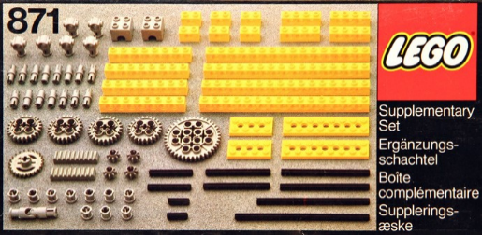
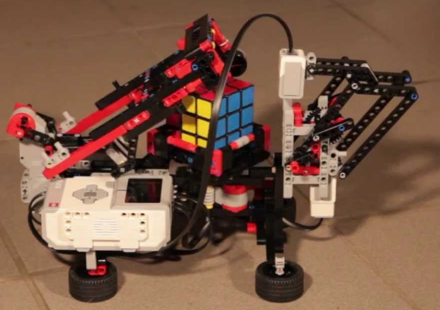
SciComp = Just Enough CompSci
Data types: int, float, bool, string
Data structures: lists, arrays, dictionaries, classes, modules
Functions: def, return
Statements: if, for, while, break
Patterns: vectorization, divide & conquer, map-reduce
Algorithms: GCD, mean/variance, sorting, searching
Modules: numpy, matplotlib, numba, scipy, sympy, scikit-learn

Slide 9
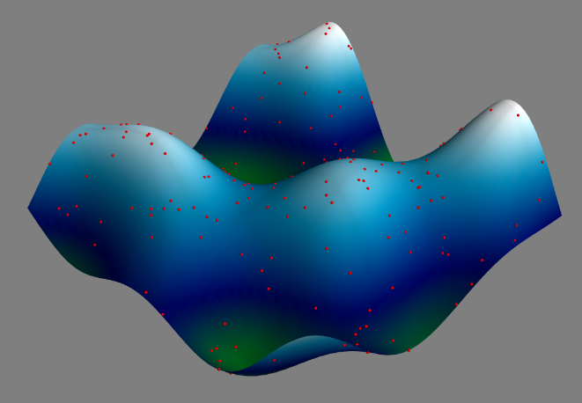
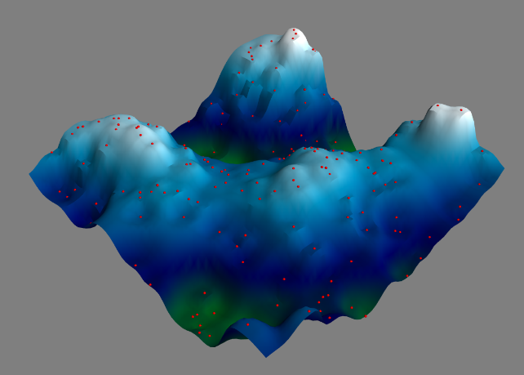
Example SciComp Topic Multidimensional Interpolation
A first order 3-D approximation of the ocean floor based upon only 220 sample (red) points (sonar timings)

Slide 10
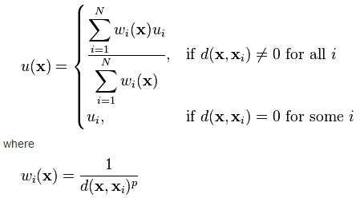
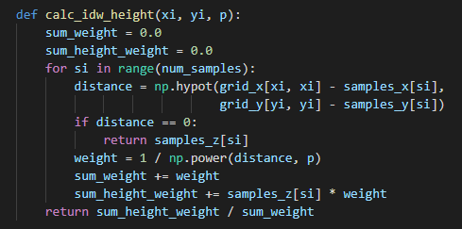
SciComp As Translational Science
"The algorithm that almost won the cold war"
SciComp is the ability to translate mathematical expressions of scientific concepts into correct and efficient software code

Slide 11
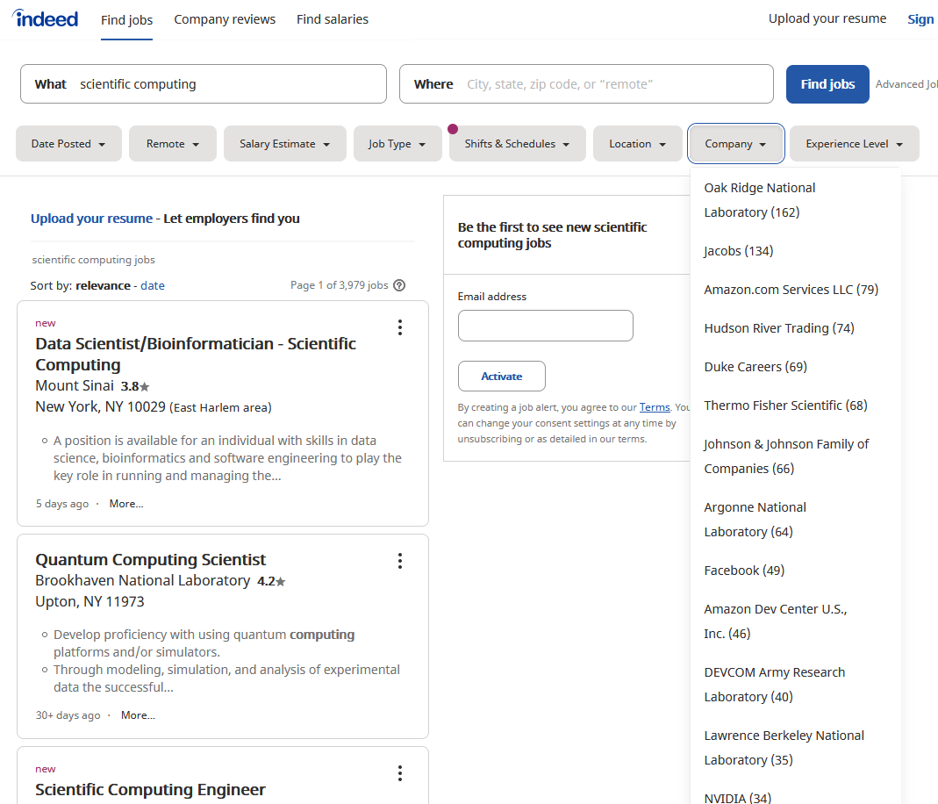
SciComp = The Pathway to Internships

Slide 12
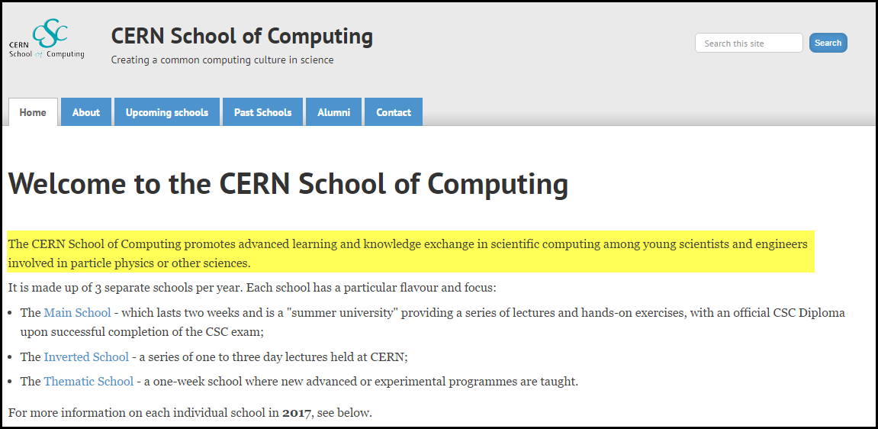
SciComp = The Pathway to Internships

Slide 13
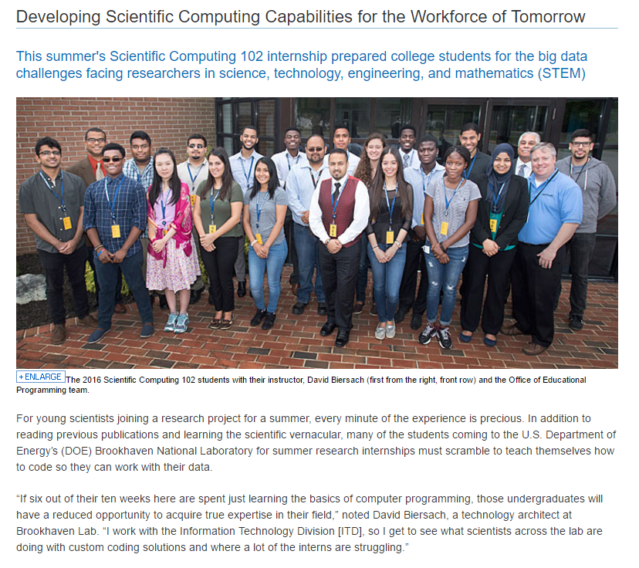

Slide 14
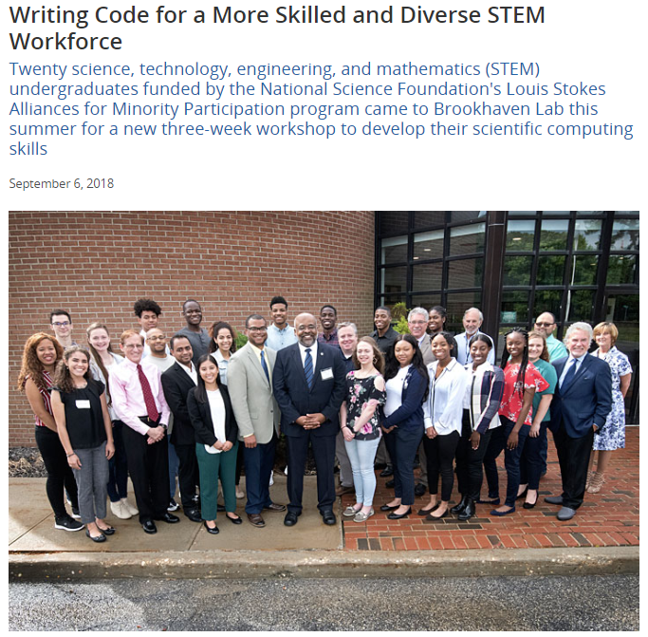

Slide 15
About Your Fellow Participants
We welcome 46 students from around the USA
California, Colorado, Illinois, Alabama, Florida, Virginia, etc.
The are four teaching assistants (TA) to help you
We cherish and protect diversity and inclusion
85% are Black/African, Hispanic/Latino, Native American
45% are female, three students are LGBTQ/Cis/Non-Binary
Experience varies significantly between students
66% are freshmen or sophomore undergraduates
50% have never taken a course in computer programming
25% have never taken a course in calculus or physics

Slide 16
Quantum Programming vs. SciComp
There are specific problem domains where quantum computing can offer special advantages versus classical scientific computing – you cannot ignore it
However, QIS does not replace SciComp – most of the coding you will do in science will be classical programming
Be "spin adverse" – avoid overselling quantum computing – know the ground state and avoid pontificating QIS hype
Be smart enough to know that we don’t know – the future impact of quantum computing is unknown at this point
Don't rush into quantum programming if you don't know how to program classical computers

Slide 17
From "Feel Good" to Solving Actual Problems
NOVA
HS
College
Grad
Post Doc
Nobel
Whimsy
GTK
Metaphors & Games
Mathematics
& Coding
Theory
& Problems
Experiments
& Questions
Discoveries
& Answers
QIS 301 is here
Undergraduates need to get a solid grip on the underlying mathematics of quantum computing
Playing is your first mode of learning, and it takes a lot of time to build an intuition on how to assemble the quantum circuits that lead to quantum algorithms
Current QIS curriculum is too heavily weighted on one end of the spectrum or the other - awareness doesn't equal skill

Slide 18
Spin Adverse
Leaning on "toy" metaphors has a definitive place in evangelizing knowledge about quantum computing, and in the early stages of student learning
However, over reliance on simplifying metaphors/games blocks the ability to map the approach to concrete mathematics
At some point you need to bring in complex algebra, matrices, and the concepts of phase & interference
How do we convey the marvel without overly accentuating the mystery?

Slide 19
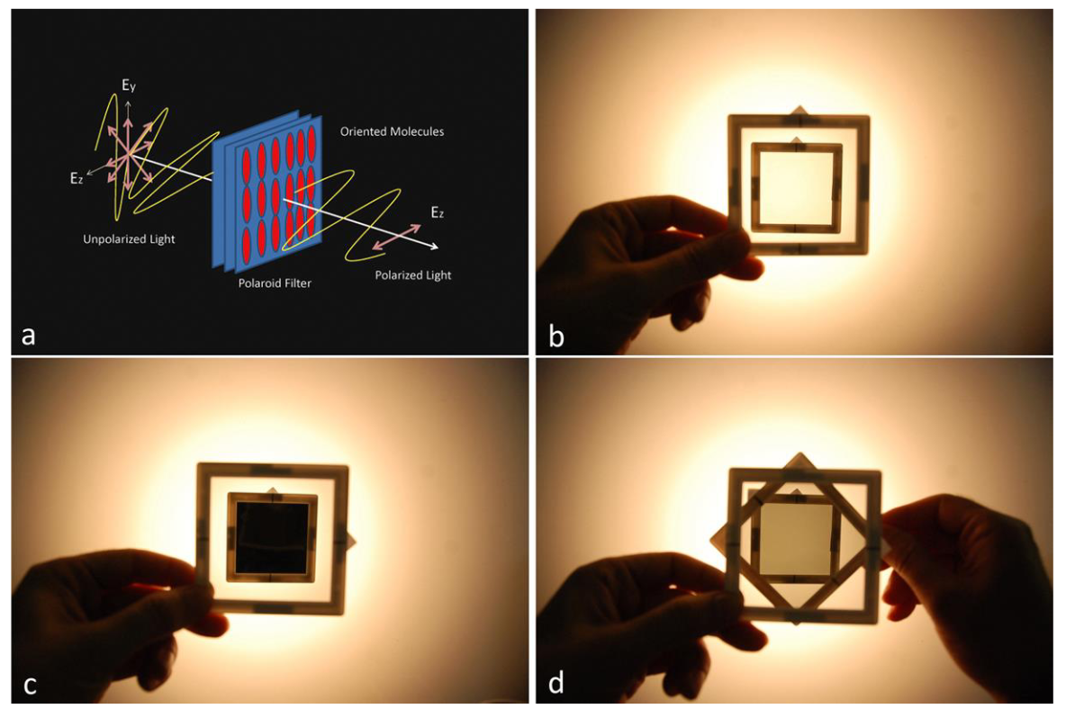
Click Bait Quantum Physics

Slide 20

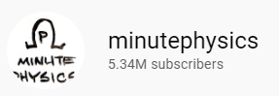
Click Bait Quantum Physics
https://www.youtube.com/watch?v=MzRCDLre1b4
In all seriousness, this is a good example and is rooted in solid mathematics, but it is a bit cliché and superficial – what do you learn from this?

Slide 21


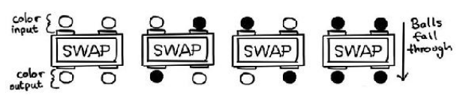
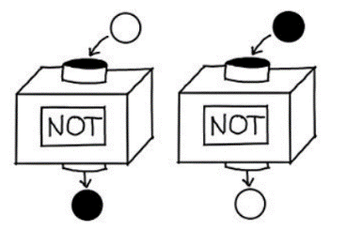
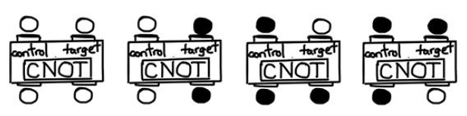
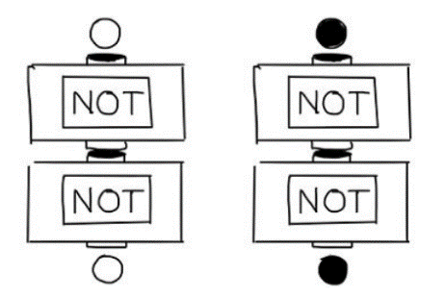
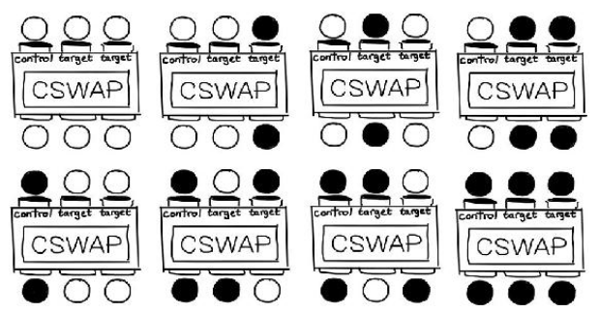
A Useful Introductory Metaphor
Terry Rudolph - Q is for Quantum
Activates if control is BLACK
Classical Boolean Logic and Gates

Slide 22
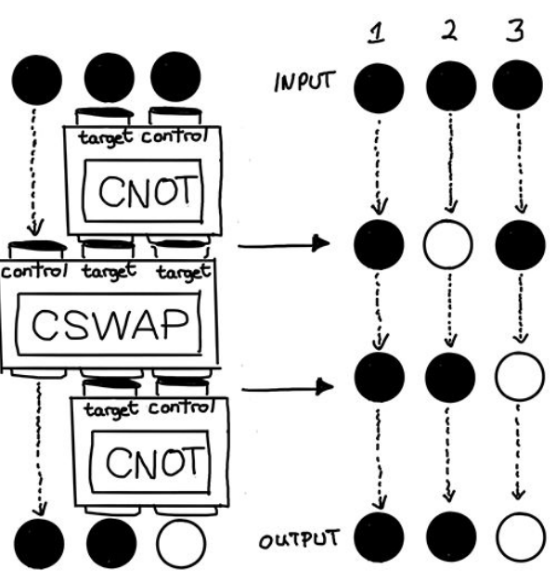
A Useful Introductory Metaphor
Terry Rudolph - Q is for Quantum
Classical Boolean Logic and Gates

Slide 23
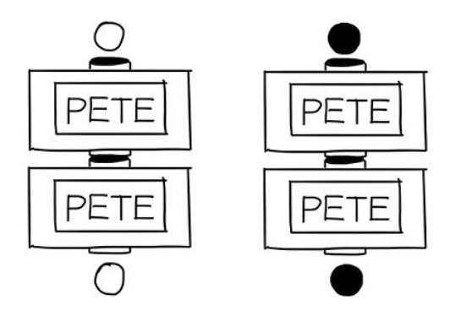
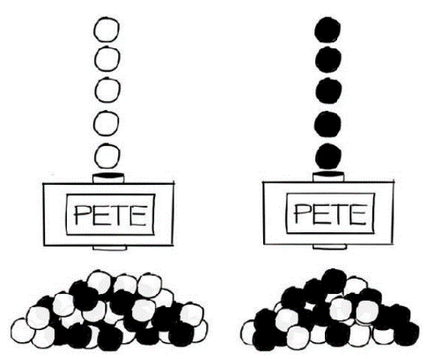
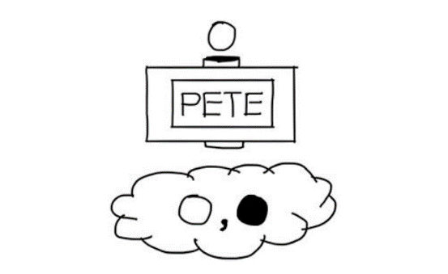
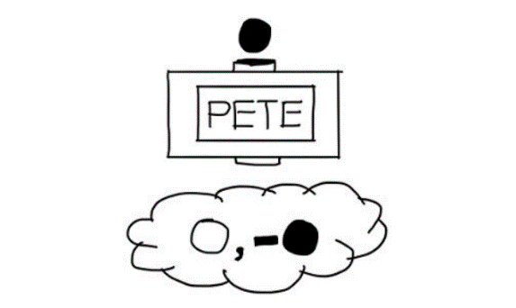
A Useful Introductory Metaphor
Terry Rudolph - Q is for Quantum
How is it always the same?
What about the 50/50?
Quantum Gates
50/50 – no way to force it
"Misty" State
Be mindful of the negative sign!

Slide 24
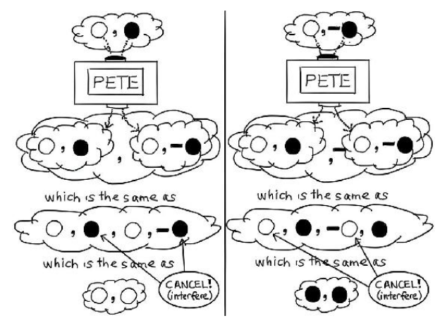
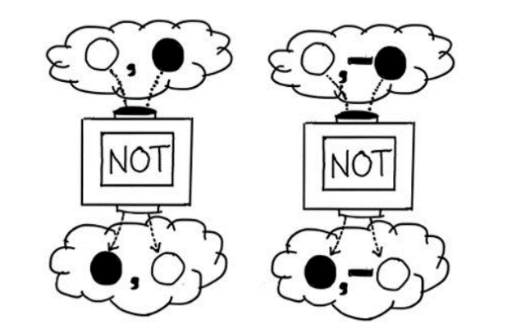
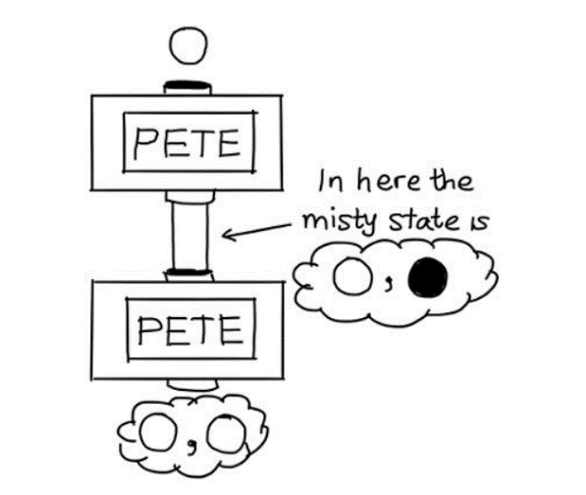
A Useful Introductory Metaphor
Terry Rudolph - Q is for Quantum

Slide 25
Quantum Information Science 301 Foundations of Quantum Computing
Objectives
Provide patterns for solving real-world science problems by writing custom software
Demonstrate how scientific computing impacts all science disciplines – and the areas where quantum computing matters
Enable students to translate scientific formulas into correct and efficient code
Place quantum computing on solid mathematical foundation
Explain the basis for quantum computing advantages & challenges
Prepare students to conduct interdisciplinary research at world-class institutions

Slide 26
Quantum Information Science 301 Foundations of Quantum Computing
Week #1 – Coding {w/Dave}
Introduction to classical coding using Python
Software Carpentry: Using Microsoft VS Code, Git, Remote Desktop
Week #2 – Math {w/Dave}
Complex Numbers and Matrices (Eigenvalues, etc.)
Wave Equations & Fourier Analysis
Week #3 – Qiskit {w/Dave}
Classical vs. Quantum Gates, Circuits & Algorithms
Jupyter Notebooks, Cybersecurity
Week #4 – Research Problems (VQE & QFT) – {w/Mike}

Slide 27
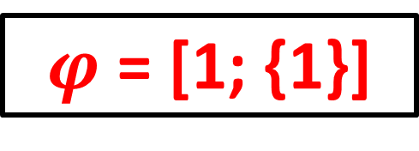
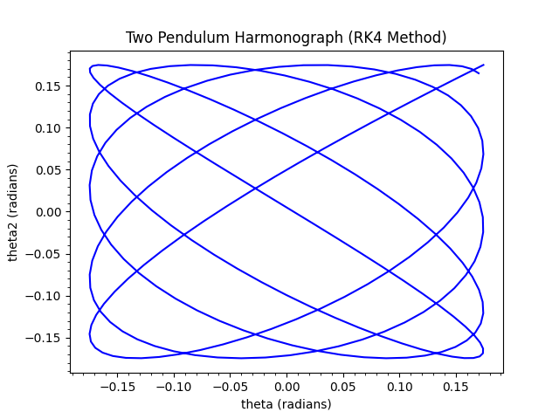
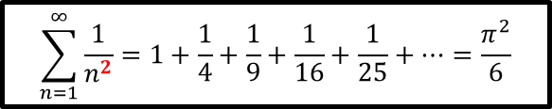
Mathematical Concepts
Probability Distributions
Calculus of Statistics
Complex Exponentials
Numerical Analysis
Differential Equations
Matrix & Tensor Algebra
Linear Regression
Monte Carlo Sampling
Wave Equations
Fourier Analysis
Dynamical Systems
$$\sum_{n=1}^{∞}{\frac{1}{n^{2}}=1+\frac{1}{4}+\frac{1}{9}+\frac{1}{16}+\frac{1}{25}+…=\frac{π^{2}}{6}}$$

Slide 28
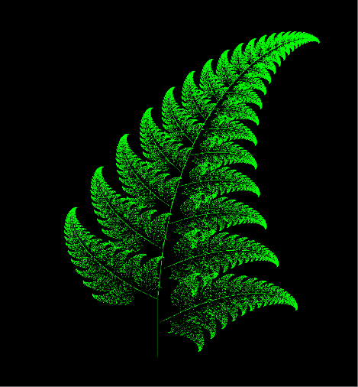
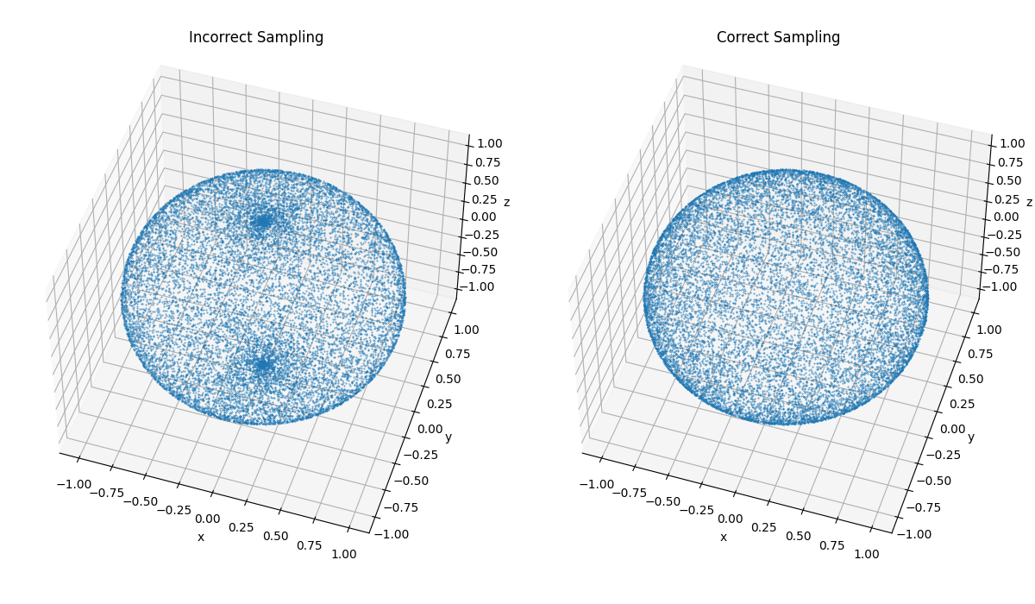
Computer Science Concepts
Representations and Encodings
Strings, Arrays, Operators
Loops, Functions, Recursion
Searching & Sorting
2D and 3D Graphics, Animation
Accuracy & Precision
Runtime Complexity
Error Correction
IBM Qiskit
Quantum Algorithms
Cybersecurity

Slide 29
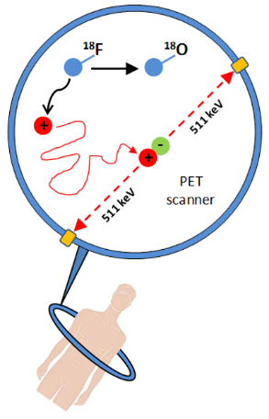
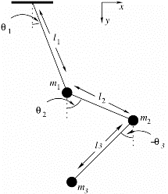
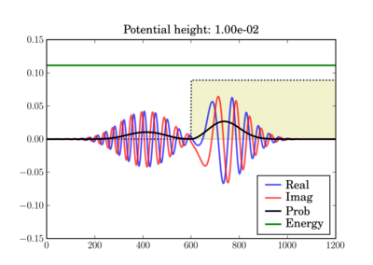
Science Concepts
Early Quantum Mechanics (Bohr)
Waves (Nyquist Theory)
Mechanics and Kinematics
Projectile Motion
Radioactive Decay
Schrodinger Wave Equation
Hamiltonians & Observables
Entanglement & Superposition
Quantum Gates & Circuits
Random Walks
Equilibrium & Thermodynamics

Slide 30
Scientific Computing with Python
Python is quickly becoming one of the most heavily used languages in science projects
Python runs on all major modern operating systems and is completely free and open-source (not vendor controlled)
Python makes it easy for your code to directly integrate with a large spectrum of available 3rd party software
Python code runs consistently on different platforms and scales well from small IoT devices to large server clusters
Python benefits from a very active and growing user community that continues to enhance the language

Slide 31
Useful Python & Qiskit Reference Sites
https://docs.python.org/3/tutorial
https://www.learnpython.org
https://realpython.com
https://www.w3schools.com/python
https://www.fullstackpython.com
https://qiskit.org/learn
https://www.youtube.com/qiskit

Slide 32
What makes Quantum Programming Hard?
The domain of achievable solutions is not universal
Requires more mathematics than basic algebra – just getting requires a significant investment
Expensive, specialized hardware is required for extensive testing and optimization of large-scale algorithms
Incorporating reversibility in algorithms is a requirement, things like a = b are not allowed without ancilla bits
Some QIS vernacular is riddled with highfalutin mumbo jumbo – lecturers/authors are often smitten with pompous complexity… some recent textbooks are unreadable
We've been teaching geometry for 3,000 years – QIS… 10

Slide 33
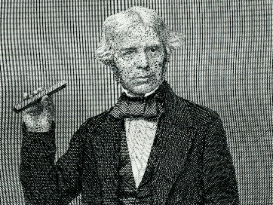
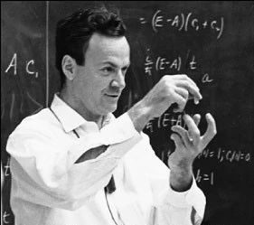
My Style
I am plain spoken and prefer concrete examples – I believe it is not what you know, but what you can teach others that is honorable
If it is bad that "only the rich get richer" then "only the smart getting smarter" is even worse – so become a lifelong learner
This isn't coffee & donuts time – you are getting paid. If people wanted to be "guided" they would have joined a safari – you work for your TAs the next four weeks
Don't treat this like a college course – I am not your professor and don't freak about "assignments" - this is your job, not a class
I expect you to work hard – let go of your student mindset – BNL is a national treasure, so bring your 'A' game

Slide 34
My Style
Don't interrupt to ask kooky, sideways, pseudo-questions just to impress everyone with how much you "know"
I'm not impressed by ego – regurgitating buzzwords means you're a parrot. Ask sincere questions – I don't mind honest confusion
Avoid the "it doesn't immediately work so I'll just freeze up and wait to be rescued" trap – there are no victims here
If it doesn't work, then dig in and fix it. There is this great new thing called Internet search…
Stop trying to memorize everything – learn to glide with it!
Don't suffer in silence, but don’t expect to become a wizard after spending ~120 hours – it takes 500 to be an expert beginner

Slide 35
Reasonable Expectations
We all learned how to read before we learned how to write
Many junior BNL staff inherit existing code to fix or extend
We learn even when we just retype other’s code
Programming is a very precise science
However, there is never just one way to solve a problem
Variability is an unsettling but necessary complication
Your assigned TA will be checking, and reporting to BNL, your daily session attendance and judging the quality of each of your labs and problem sets
If you cannot make a session, please inform your TA
Do not fall behind – each session builds off the next

Slide 36
Key Points about SciComp
It does not take thousands of lines of code to keep importance science moving right along…
You don’t have to be a professional programmer or know all the arcane aspects of computer languages
The closer you get to cutting edge science, the less likely you’ll be able to just “download an app” to accomplish what you need
If you don’t know how to code…
You will at some point start to subconsciously limit the types of analysis you can perform because you will remain at the mercy of the available software
Should software shape your science, or instead, will you shape software to advance your science?

Slide 37
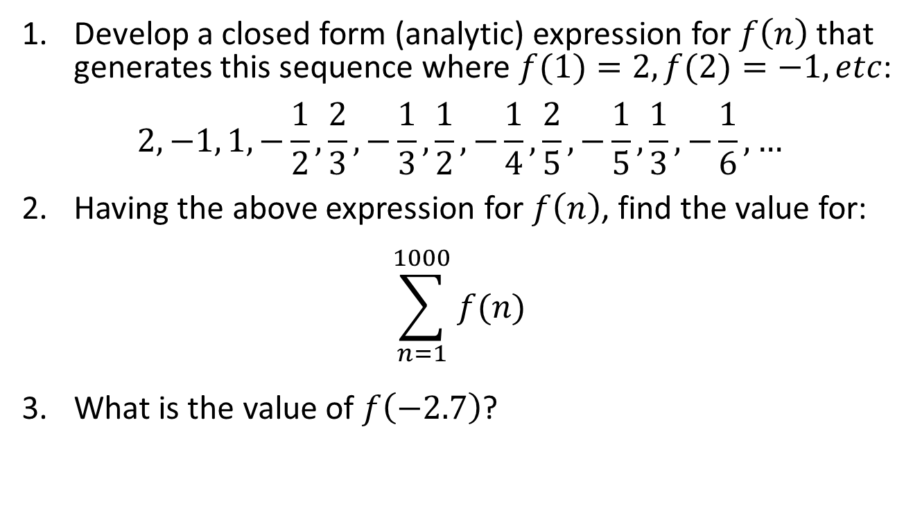
Impress Me
Develop a closed form (analytic) expression for $f\left(n\right)$ that generates this sequence where $f(1)=2,f(2)=−1, etc$:
$$2, −1, 1, −\frac{1}{2}, \frac{2}{3},−\frac{1}{3},\frac{1}{2}, −\frac{1}{4},\frac{2}{5},−\frac{1}{5},\frac{1}{3},−\frac{1}{6}, …$$
Having the above expression for $f\left(n\right)$, find the value for:
$$\sum_{n=1}^{1000}{f(n)}$$
What is the value of $f\left(−2.7\right)$?

Slide 38
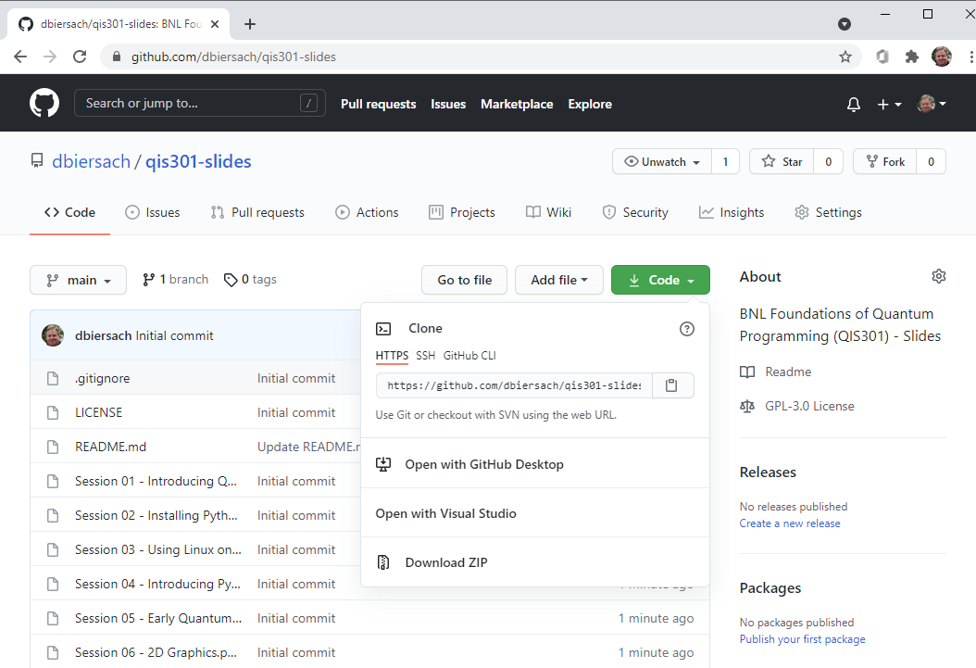
Download These Presentations
https://github.com/dbiersach/qis301-slides

